Slide 1
Designing and Analysis of Algorithm
Dr. Han Huang
South China University of Technology

Slide 2


Chapter 3
Brute Force
Copyright © 2007 Pearson Addison-Wesley. All rights reserved.

Slide 3
Brute Force
Science is as far removed from brute force as this sword from a crowbar (撬棍).
-------- Edward Lytton (1803-1873)
Doing a thing well is often a waste of time.
-------- Robert Byrne, master pool and billiards player and writer

Slide 4
Brute force
Brute force is a straightforward approach to solving a problem, usually directly based on the problem statement and definitions of the concepts involved.
“Just do it !” would be another way to describe the prescription of the brute-force approach.

Slide 5
Brute Force
A straightforward approach, usually based directly on the problem’s statement and definitions of the concepts involved
Examples:
Computing a^{n} (a > 0, n is a nonnegative integer)
Computing n!
Multiplying two matrices
Searching for a key of a given value in a list

Slide 6
3.1 Brute-force Sorting

Slide 7
Brute-Force Sorting Algorithm
Selection Sort Scan the array to find its smallest element and swap it with the first element. Then, starting with the second element, scan the elements to the right of it to find the smallest among them and swap it with the second elements. Generally, on pass i (0 ≤ i ≤ n-2), find the smallest element in
A[i..n-1] and swap it with A[i]:
A[0] ≤ . . . ≤ A[i-1] | A[i], ... , A[min], ..., A[n-1]
in their final positions the last n-i elements
Example: 7 3 2 5

Slide 8
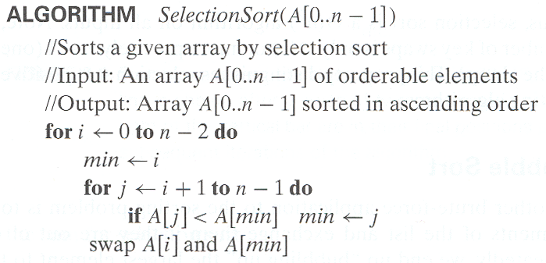
Selection Sort
Step1:初始化未排序数组最小位置下标
Step2:更新未排序数组最小位置下标
Step3:将数组最小位放置到已排序数组的合适位置

Slide 9
Example of Selection Sort
The input’s size is given by the number of elements n; the algorithm’s basic operation is the key comparison A[j] < A[min].
| 89 45 68 90 29 34 17
17 | 45 68 90 29 34 89
17 29 | 68 90 45 34 89
17 29 34 | 90 45 68 89
17 29 34 45 | 90 68 89
17 29 34 45 68 | 90 89
17 29 34 45 68 89 | 90

Slide 10
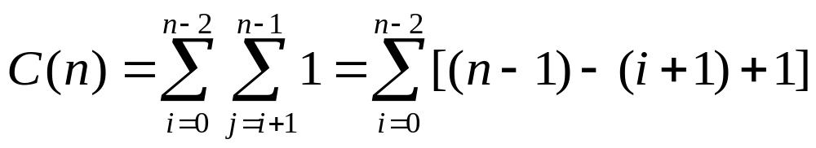
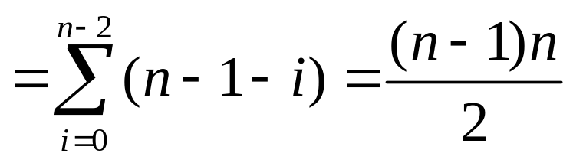
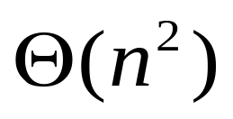
Time Complexity of Selection Sort

Slide 11
Bubble Sort
Another brute-force application to the sorting problem is to compare adjacent elements of the list and exchange them if they are out of order.
By doing it repeatedly, we end up “bubbling up” the largest element to the last position on the list.
A[0],…,A[j] ←→ A[j+1], … , A[n-i-1] | A[n-i] ≤…≤A[n-1]
in their final position

Slide 12
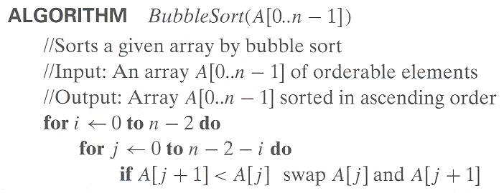
Bubble Sort

Slide 13
Example of Bubble Sort
89 ←→ 45 68 90 29 34 17
45 89 ←→ 68 90 29 34 17
45 68 89 ←→ 90 ←→ 29 34 17
45 68 89 29 90 ←→ 34 17
45 68 89 29 34 90 ←→ 17
45 68 89 29 34 17 | 90
45 ←→ 68 ←→ 89 ←→ 29 34 17 | 90
45 68 29 89 ←→ 34 17 | 90
45 68 29 34 89 ←→ 17 | 90
45 68 29 34 17 | 89 90
……

Slide 14
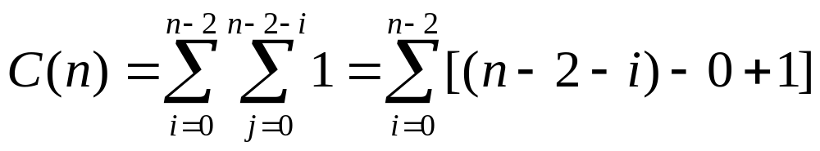
Time Complexity of Bubble Sort

Slide 15
3.2 Sequential Search and Brute-Force String Matching

Slide 16
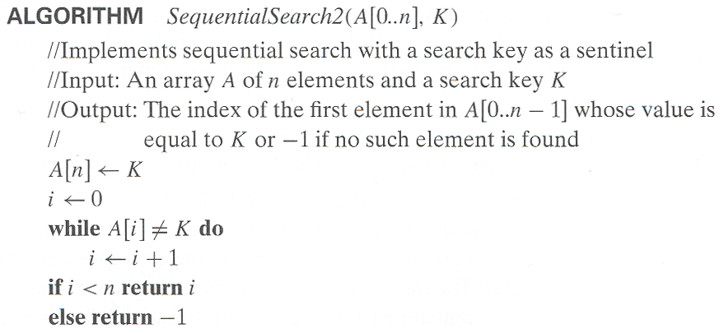
Sequential Search
Step1：初始化下标
Step2：顺序搜索
Step3：搜索到结果返回下标，否则返回-1

Slide 17
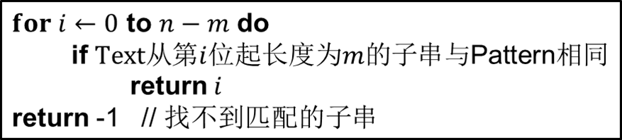
Example of Brute-Force String Matching
Pattern: 001011 Text: 10010101101001100101111010
10010101101001100101111010
001011
10010101101001100101111010
001011
…
10010101101001100101111010
Matched!!
001011

Slide 18
Example of Brute-Force String Matching
Pattern: happy Text: It is never too late to have a happy childhood.
It is never too late to have a happy childhood.
happy
It is never too late to have a happy childhood.
happy
…
It is never too late to have a happy childhood.
happy
Matched!!

Slide 19
Brute-Force String Matching
pattern: a string of m characters to search for
text: a (longer) string of n characters to search in
problem: find a substring in the text that matches the pattern
Brute-force algorithm
Step 1 Align pattern at beginning of text
Step 2 Moving from left to right, compare each character of
pattern to the corresponding character in text until
    all characters are found to match (successful search); or
    a mismatch is detected
Step 3 While pattern is not found and the text is not yet
exhausted, realign pattern one position to the right and
repeat Step 2

Slide 20
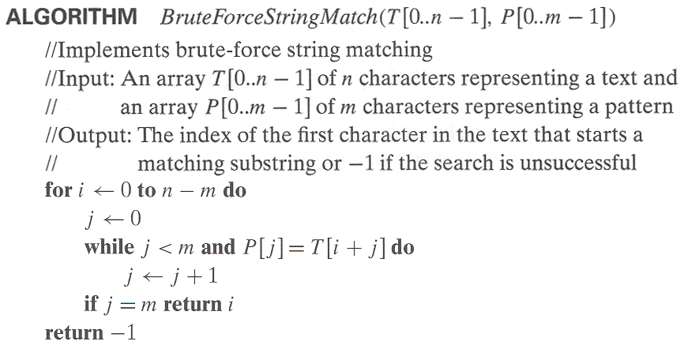
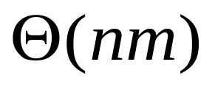
Pseudocode and Efficiency
Step1:初始化匹配长度
Step2:T和P之间逐条匹配
Step3:T和P之间如果完全匹配返回匹配成功的下标；否则返回-1
Efficiency:

Slide 21
Brute-Force String Matching
t[0] … t[i] … t[i+j] … t[i+m-1] … t[n-1] text T
p[0] … p[j] … p[m-1] pattern P
The worst case is much worse: the algorithm may have to make all m comparisons before shifting the pattern, and this can happen for each of the n-m+1 tries.

Slide 22
Brute-Force String Matching
Text:
A C A B C A D A B C A B C B
Pattern:
A B C A B C
D不存在于Patten中
A C A B C A D A B C A B C B
浪费的算力：
以D和D前的m-1个字符为起点都不可能实现完全匹配,
可跳过该区域
A C A B C A D A B C A B C B
A C A B C A D A B C A B C B
A B C A B C
A B C A B C
直接跳过6个字符

Slide 23
3.3 Closest-Pair Problem

Slide 24
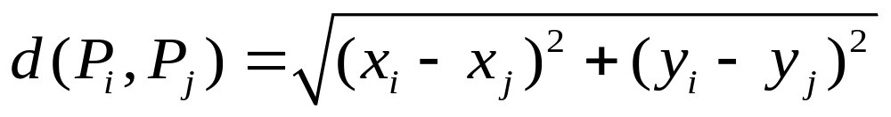
Closest-Pair Problem
Find the two closest points in a set of n points (in the two-dimensional Cartesian plane).
Brute-force algorithm
Compute the distance between every pair of distinct points and return the indexes of the points for which the distance is the smallest.
Notes:
Draw example.

Slide 25
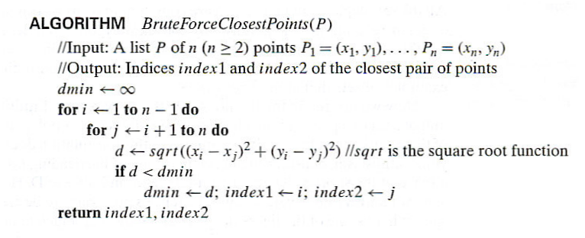
Closest-Pair Brute-Force Algorithm
Step1:遍历所有点对，计算两点距离
Step2:将计算得到的点的距离与记录的最小距离对比，如果比最小距离更小则更新最小距离
Notes:
The basic operation of the algorithm is computing the Euclidean distance between two points.
The square root is a complex operation who’s result is often irrational, therefore the results
can be found only approximately. Computing such operations are not trivial. One can avoid
computing square roots by comparing distance squares instead.

Slide 26
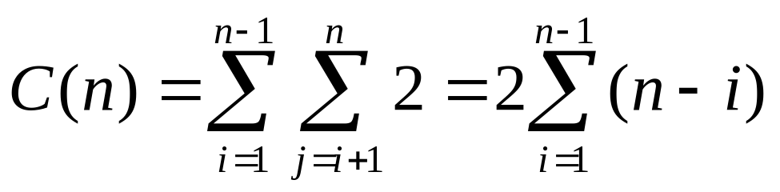
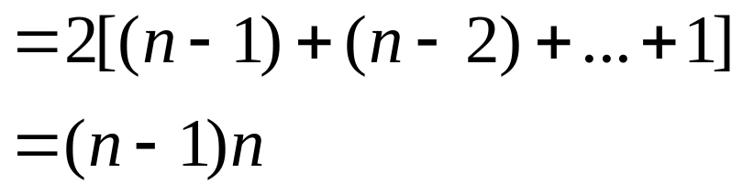
Time Complexity of Closest-Pair Brute-Force Algorithm

Slide 27
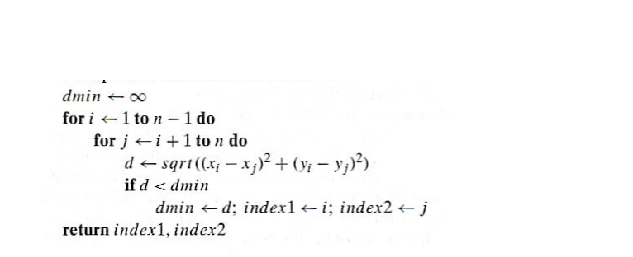

Example of Closest-Pair Brute-Force Algorithm
Point | (x, y)
P1 | (1, 2)
P2 | (4, 2)
P3 | (3, 1)
P4 | (2, 6)

Slide 28
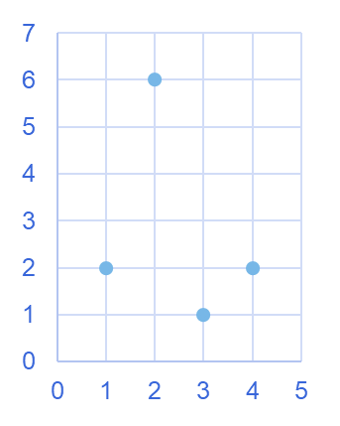
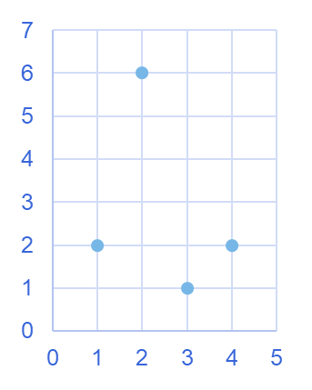

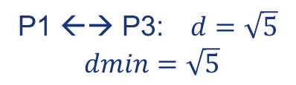
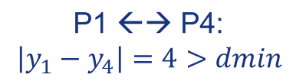

Closest-Pair Brute-Force Algorithm
P4
P4
P1
P1
P2
P2
P3
P3
浪费的算力：

Slide 29
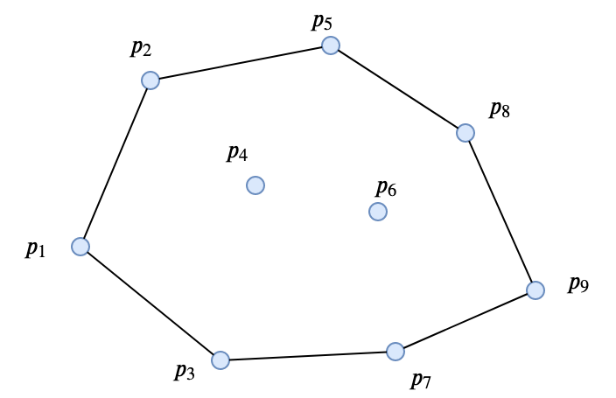
Convex-Hull Problem
Definition A set of points (finite or infinite) in the plane is called convex if for any two points P and Q in the set, the entire line segment with the endpoints at P and Q belongs to the set.
Definition The convex hull of a set S of points is the smallest convex set containing S.
(The “smallest” requirement means that the convex hull of S must be a subset of any convex set containing S.)

Slide 30
Convex-Hull Problem
Theorem The convex hull of any set S of n>2 points (not all on the same line) is a convex polygon with the vertices at some of the points of S. (If all the points do lie on the same line, the polygon degenerates to a line segment but still with the endpoints at two points of S.)

Slide 31
Convex-Hull Problem
The convex-hull problem is the problem of constructing the convex hull for a given set S of n points.
To solve it, we have to find the points that will serve as the vertices of the polygon in question.
Mathematicians call vertices of such a polygon “extreme points.”

Slide 32
Convex-Hull Problem
Extreme points have several special properties other points of a convex set do not have. One of them is exploited by a very important algorithm called the simplex method.
This algorithm solves linear programming
problems, problems of finding a minimum or a maximum of a linear function of n variables subject to linear constraints.
(Section 6.6 and 10.1)

Slide 33
3.4 Exhaustive Search

Slide 34
Exhaustive Search
A brute force solution to a problem involving search for an element with a special property, usually among combinatorial objects such as permutations, combinations, or subsets of a set.
Method:
  generate a list of all potential solutions to the problem in a systematic manner (see algorithms in Sec. 5.4)
  evaluate potential solutions one by one, disqualifying infeasible ones and, for an optimization problem, keeping track of the best one found so far
  when search ends, announce the solution(s) found

Slide 35
Example 1: Traveling Salesman Problem
Given n cities with known distances between each pair, find the shortest tour that passes through all the cities exactly once before returning to the starting city
Alternatively: Find shortest Hamiltonian circuit in a weighted connected graph
Example:
2
a
b
8
7
5
3
c
d
1

Slide 36
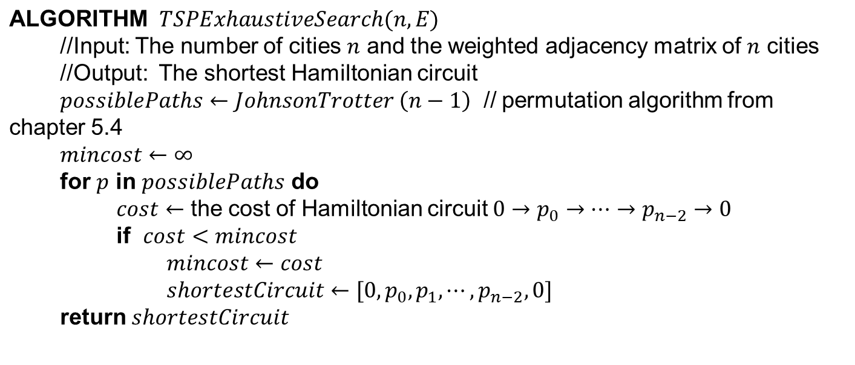
Example 1: Traveling Salesman Problem
Step1:获取所有可能的哈密顿回路
Step2:计算所有哈密顿回路的成本
Step3:选取成本最小的哈密顿回路

Slide 37
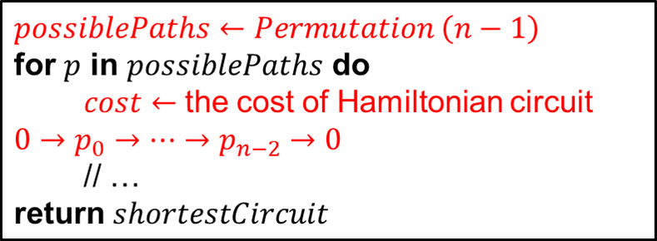
TSP by Exhaustive Search
Tour Cost
a→b→c→d→a 2+8+1+7 = 18
a→b→d→c→a 2+3+1+5 = 11
a→c→b→d→a 5+8+3+7 = 23
a→c→d→b→a 5+1+3+2 = 11
a→d→b→c→a 7+3+8+5 = 23
a→d→c→b→a 7+1+8+2 = 18
More tours?
Less tours?
Efficiency:
2
a
b
8
7
5
3
c
d
1

Slide 38
TSP by Exhaustive Search
Tour Cost
a→b→c→d→a 2+8+1+7 = 18
a→b→d→c→a 2+3+1+5 = 11
a→c→b→d→a 5+8+3+7 = 23
a→c→d→b→a 5+1+3+2 = 11
a→d→b→c→a 7+3+8+5 = 23
a→d→c→b→a 7+1+8+2 = 18
浪费的算力:
顺序相反的路径只需计算其中一个

Slide 39
Example 2: Knapsack Problem
Given n items:
  weights: w₁ w₂ … w_{n}
  values: v₁ v₂ … v_{n}
  a knapsack of capacity W
Find most valuable subset of the items that fit into the knapsack
Example: Knapsack capacity W=10
item weight value
7 $42
3 $12
4 $40
5 $25

Slide 40
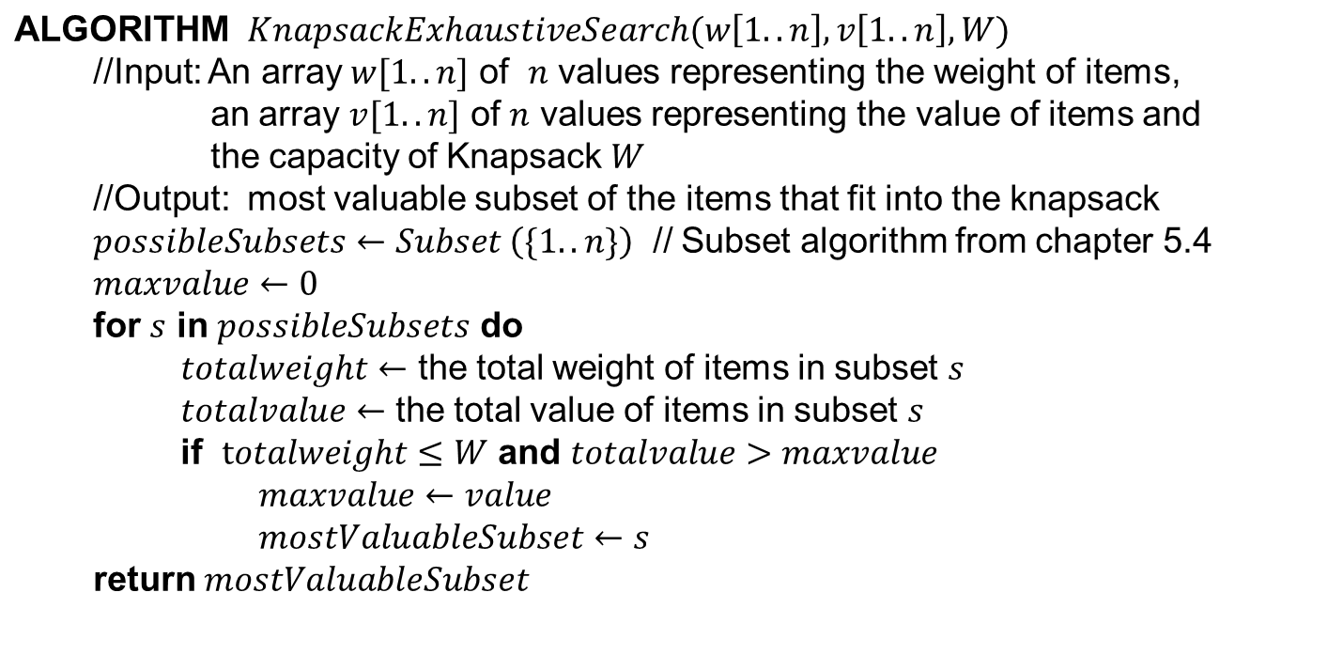
Example 2: Knapsack Problem
Step1:获取所有可能的物品子集
Step2:计算物品子集的总重量和总价值
Step3:选取可放进背包的价值最高的物品子集

Slide 41
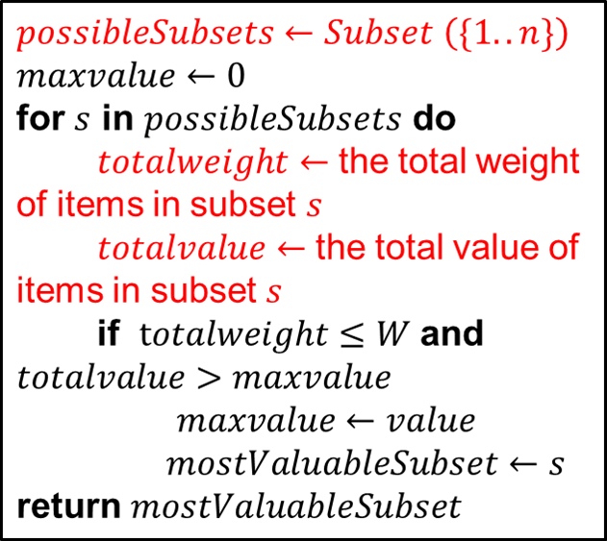
Knapsack Problem by Exhaustive Search
Subset Total weight Total value
{1} 7 $42
{2} 3 $12
{3} 4 $40
{4} 5 $25
{1,2} 10 $36
{1,3} 11 not feasible
{1,4} 12 not feasible
{2,3} 7 $52
{2,4} 8 $37
{3,4} 9 $65
{1,2,3} 14 not feasible
{1,2,4} 15 not feasible
{1,3,4} 16 not feasible
{2,3,4} 12 not feasible
{1,2,3,4} 19 not feasible

Slide 42
Knapsack Problem by Exhaustive Search
Subset Total weight Total value
{1} 7 $42
{2} 3 $12
{3} 4 $40
{4} 5 $25
{1,2} 10 $36
{1,3} 11 not feasible
{1,4} 12 not feasible
{2,3} 7 $52
{2,4} 8 $37
{3,4} 9 $65
{1,2,3} 14 not feasible
{1,2,4} 15 not feasible
{1,3,4} 16 not feasible
{2,3,4} 12 not feasible
{1,2,3,4} 19 not feasible
浪费的算力：
超重的子集添加更多物品后依然超重，可节省用于超重子集超集的算力

Slide 43
Knapsack Problem by Exhaustive Search
Subset Total weight Total value
{1} 7 $42
{2} 3 $12
{3} 4 $40
{4} 5 $25
{1,2} 10 $36
{1,3} 11 not feasible
{1,4} 12 not feasible
{2,3} 7 $52
{2,4} 8 $37
{3,4} 9 $65
{1,2,3} 14 not feasible
{1,2,4} 15 not feasible
{1,3,4} 16 not feasible
{2,3,4} 12 not feasible
{1,2,3,4} 19 not feasible
浪费的算力：
超集的重量和价值可在子集的基础上计算
= {1,2} U {3}
= 10 + 4

Slide 44
Example 3: The Assignment Problem
There are n people who need to be assigned to n jobs, one person per job. The cost of assigning person i to job j is C[i,j]. Find an assignment that minimizes the total cost.
Job 0 Job 1 Job 2 Job 3
Person 0 9 2 7 8
Person 1 6 4 3 7
Person 2 5 8 1 8
Person 3 7 6 9 4
Algorithmic Plan: Generate all legitimate assignments, compute their costs, and select the cheapest one. How many assignments are there?
Pose the problem as the one about a cost matrix:

Slide 45
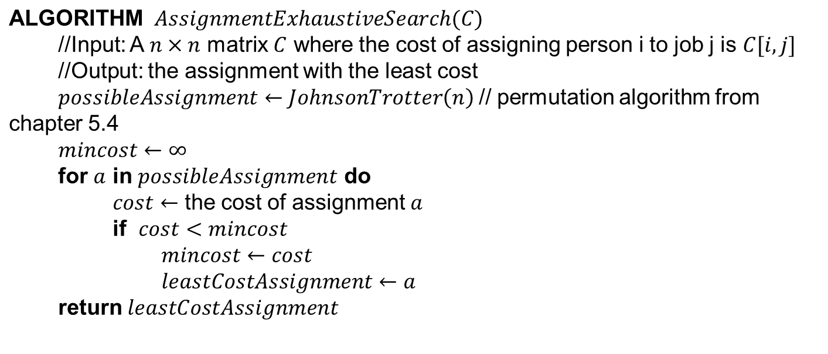
Example 3: The Assignment Problem
Step1:获取所有可能的分配方案
Step2:计算每个分配方案的成本
Step3:选取成本最小的分配方案

Slide 46
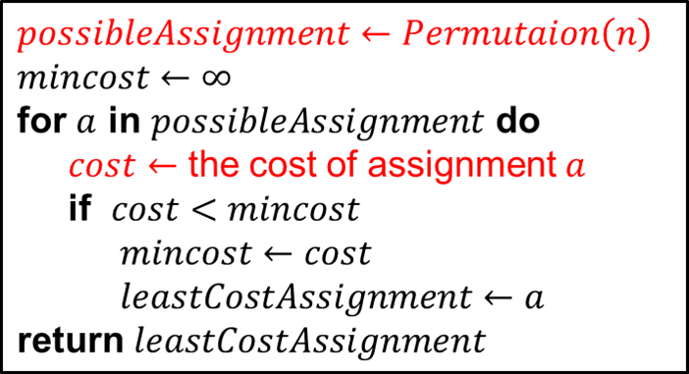
Assignment Problem by Exhaustive Search
9 2 7 8
6 4 3 7
5 8 1 8
7 6 9 4
Assignment (col.#s) Total Cost
1, 2, 3, 4 9+4+1+4=18
1, 2, 4, 3 9+4+8+9=30
1, 3, 2, 4 9+3+8+4=24
1, 3, 4, 2 9+3+8+6=26
1, 4, 2, 3 9+7+8+9=33
1, 4, 3, 2 9+7+1+6=23
etc.
(For this particular instance, the optimal assignment can be found by exploiting the specific features of the number given.)
C =

Slide 47
Assignment Problem by Exhaustive Search
9 2 7 8
6 4 3 7
5 8 1 8
7 6 9 4
Assignment (col.#s) Total Cost
1, 2, 3, 4 9+4+1+4=18
1, 2, 4, 3 9+4+8+9=30
1, 3, 2, 4 9+3+8+4=24
1, 3, 4, 2 9+3+8+6=26
1, 4, 2, 3 9+7+8+9=33
1, 4, 3, 2 9+7+1+6=23
etc.
(For this particular instance, the optimal assignment can be found by exploiting the specific features of the number given.)
C =
浪费的算力：
不同的分配方案中存在部分相同的分配子方案而导致的重复计算

Slide 48
Final Comments on Exhaustive Search
Exhaustive-search algorithms run in a realistic amount of time only on very small instances
In some cases, there are much better alternatives!
  Euler circuits
  shortest paths
  minimum spanning tree
  assignment problem
In many cases, exhaustive search or its variation is the only known way to get exact solution

Slide 49
3.5 Comments on Brute-force Algorithm

Slide 50
Brute-Force Polynomial Evaluation
Problem: Find the value of polynomial
p(x) = a_{n}x^{n} + a_{n-1}x^{n-1} +… + a₁x¹ + a₀
at a point x = x₀
Brute-force algorithm
Efficiency:
p ← 0.0
for i ← n down to 0 do
power ← 1
  for j ← 1 to i do //compute x^{i}
  power ← power ∗ x
  p ← p + a[ i ] ∗ power
Step1：初始化X
Step2：初始化X的k次方
Step3：累加计算多项式的值
return p

Slide 51
Polynomial Evaluation: Improvement
We can do better by evaluating from right to left:
Better brute-force algorithm
p ← a[0]
power ← 1
for i ← 1 to n do
    power ← power ∗ x
  p ← p + a[ i ] ∗ power
  return p

Slide 52
Polynomial Evaluation: Improvement
We can do better by evaluating from right to left:
Better brute-force algorithm
p ← a[0]
power ← 1
for i ← 1 to n do
    power ← power ∗ x
  p ← p + a[ i ] ∗ power
  return p
节省的重复计算：
节省了计算幂时重复的乘法操作
可节省的多余算力：
可借助乘法的分配律节省乘法操作的数量

Slide 53
Brute-Force Strengths and Weaknesses
Strengths
  wide applicability
  simplicity
  yields reasonable algorithms for some important problems
  (e.g., matrix multiplication, sorting, searching, string matching)
Weaknesses
  rarely yields efficient algorithms
  some brute-force algorithms are unacceptably slow
  not as constructive as some other design techniques

Slide 54
Exercise

Slide 55
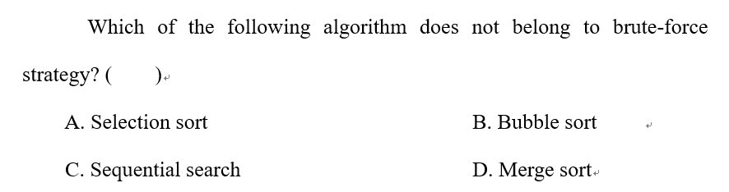
Exercise

Slide 56
Exercise

Slide 57
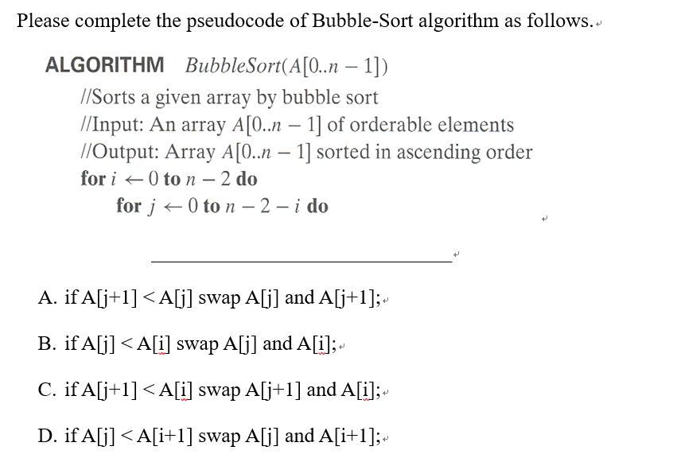
Exercise

Slide 58
Exercise

Slide 59
Exercise
给定一个n个字符组成的串A，一个m个字符的串B，从A中到出B字符串出现的第一个位置。如果不存在，则返回-1
1）请写出蛮力算法伪代码，并分析时间复杂度

Slide 60
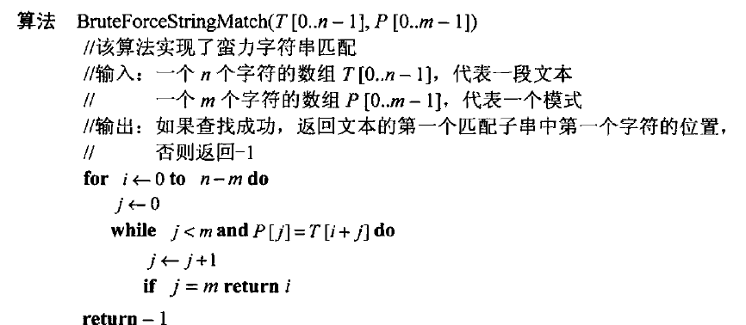
Exercise
给定一个n个字符组成的串A，一个m个字符的串B，从A中到出B字符串出现的第一个位置。如果不存在，则返回-1
1）请写出蛮力算法伪代码，并分析时间复杂度
时间复杂度：O(n*m)

Slide 61
End of the Section 3
Click to edit company slogan .

